Slide 1
ACCIDENT PREDECTION AND PREVENTION USING DATA-DRIVEN MODELS
ZEROTH REVIEW
Guided by,
Dr.R.Nallakumar,
Assistant Professor,
Department of Artificial Intelligence and Data Science,
Karpagam Institute of Technology,
Coimbatore.
Presented by
S.LINKEDH(721220243028)
M.NATHISH(721220243035)
M.PRASANTH(721220243045)
K. SRIKANTH(721220243053)
Department of Artificial Intelligence and Data Science,
Karpagam Institute of Technology,
Coimbatore.

Slide 2
Introduction (ACCIDENT ANALYSIS AND PREVENTION )
The Project aims to analyze road accidents using machine learning to identify patterns and contributing factors, which can help in developing preventive measures.
By analyzing accident data, the model can predict accident-prone areas and provide insights into the causes of accidents. The use of machine learning can enable real-time data analysis to provide quicker and more accurate insights.
The ultimate goal is to reduce the number of accidents and save lives on the roads.

Slide 3
Problem Identification
DATA QUALITY: The accuracy and completeness of accident data can vary, and data from different sources may not be compatible, making it difficult to generate insights.
FEATURE SELECTION: Selecting the right features that contribute to accident occurrence and severity can be challenging, especially since there can be many interrelated factors.
ETHICAL CONSIDERATIONS: The use of ML for accident analysis raises ethical considerations, such as issues related to privacy, bias, and discrimination.
MODEL INTERPRETABILITY: ML models can be difficult to interpret, which makes it challenging to understand why the model is making certain predictions.

Slide 4
Proposed Work (Combination of K-Nearest Neighbors (KNN) and Decision Trees Algorithm)
The proposed work aims to analyze road accidents using machine learning, specifically by utilizing a combination of K-Nearest Neighbors (KNN) and Decision Trees algorithms.
The KNN (K-Nearest Neighbors) Algorithm helps to identify similar accidents based on their features, while the Decision Tree Algorithm helps to identify the most important features for predicting the accident outcome.
The combination of these two algorithms can improve the accuracy, robustness, interpretability, and flexibility of the model.
By analyzing accident data, the model can predict accident-prone areas and provide insights into the causes of accidents. The ultimate goal is to reduce the number of accidents and save lives on the roads.

Slide 5
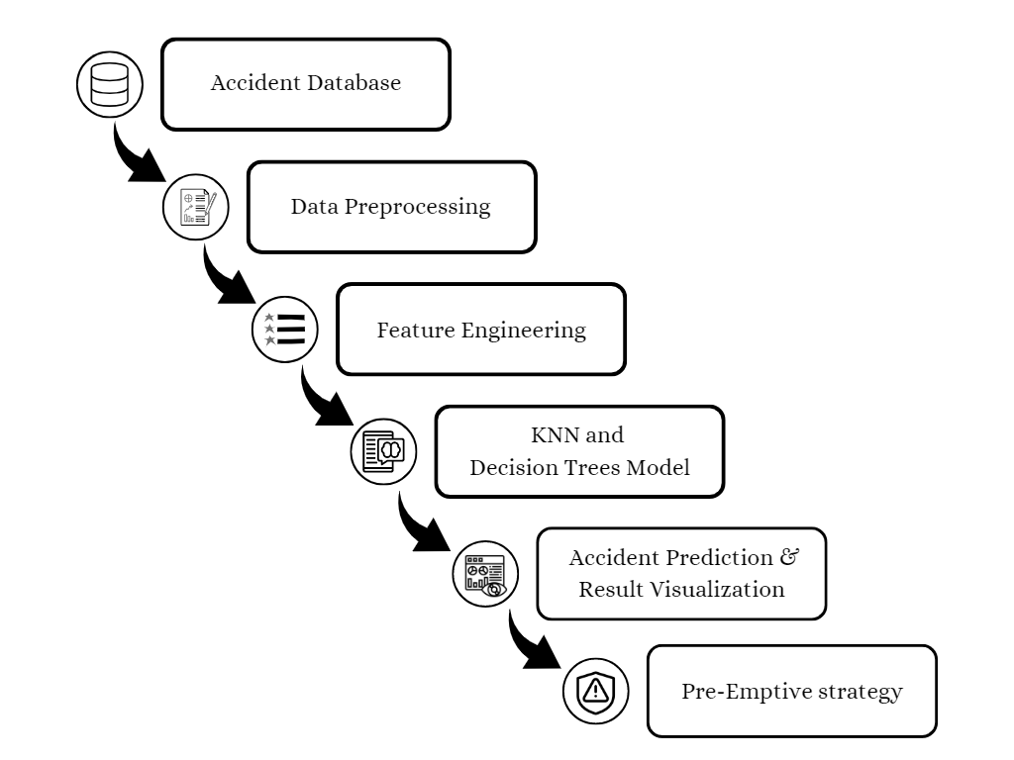
System Architecture

Slide 6
Algorithm implemented
K-Nearest Neighbors (KNN)
K-Nearest Neighbors (KNN) is a non-parametric machine learning algorithm used for classification and regression by identifying k number of data points that are closest to a given data point.
Decision Trees
Decision Trees is a machine learning algorithm used for classification and regression. It creates a tree-like model of decisions and their possible consequences based on the features of the data.

Slide 7
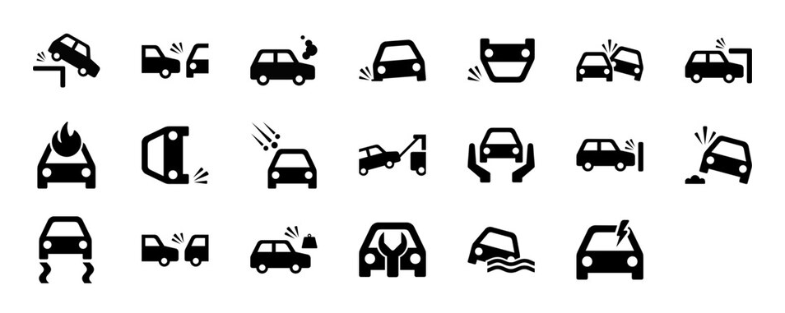
Expected Deliverables
Improved accident prevention strategies
Accurate accident prediction
Increased public safety
Better resource allocation
Enhanced decision-making

Slide 8
References
Tingting Huang , Shuo Wang, Anuj Sharma
Highway crash detection and risk estimation using deep learning
Accident Analysis & Prevention, Volume 135, February 2020, 105392
Ammar Almasri, Sadiq Hussain, Maregu Assefa
Classification of Road Traffic Accident Data Using Machine Learning Algorithms
2019 IEEE 11th International Conference on Communication Software and Networks
Md. Farhan Labib, Ahmed Sady Rifat, Md. Mosabbir Hossain, Amit Kumar Das, Faria Nawrine
Road Accident Analysis and Prediction of Accident Severity by Using Machine Learning
2019 7th International Conference on Smart Computing & Communications (ICSCC)

Slide 9
Thank You!

